Slide 1
CSE 462
Vertex Cover Problem
Team ID: 6
1805073
1805075
1805098
1805104

Slide 2
Overview
1. Intro, Definition, Application
2. Approximate Algorithm
3. Randomized Algorthm
4. Greedy Heuristic Algorithm

Slide 3
Intro, Definition, Application
1805075

Slide 4
Definition and Basic Concept
Definition:
A vertex cover of a graph is a set of vertices such that each edge in the graph is incident to at least one vertex in the set.
In simpler terms, it is a group of vertices strategically chosen to cover all connections within the graph.
Given an undirected graph or simply a graph is a pair G = (V,E) where V ≠∅ is a set of vertices and E ⊆ {{u,v} ⊆ V : u ≠v} is a set of edges.
A vertex cover of a graph G = (V,E) is a set S ⊆ V such that for every edge {u,v} 𝞊 E we have {u,v} ∩ S ≠ ∅

Slide 5
Illustrating Vertex Cover with Examples
D
B
D
B
C
C
A
A
E
E
G
F
G
F

Slide 6
Illustrating Vertex Cover with Examples
D
B
C
D
B
D
B
C
C
A
A
E
F
G
A
E
E
G
F
G
F
{B, C, E, D, F, G} is a vertex cover

Slide 7
Illustrating Vertex Cover with Examples
D
B
C
D
B
D
B
C
C
A
A
E
F
G
A
E
E
G
F
G
F
{A, C, D, F} is a minimal vertex cover

Slide 8
Illustrating Vertex Cover with Examples
D
B
C
D
B
D
B
C
C
A
A
E
F
G
A
E
E
G
F
G
F
{B, D, E} is a minimum vertex cover

Slide 9
Minimum Vertex Cover
Definition:
The smallest set of vertices that covers all edges in a graph.
Decision Version of Vertex Cover
Given a graph G and integer k, does G have a vertex cover of size at most k?
Given: A graph
Task: Output a vertex cover of smallest size.

Slide 10

Applications of Vertex Cover
Vertex Cover has many real life applications. Let us explore!

Slide 11



Network Design and Optimization
Resource Allocation
Scheduling and Time Management
Telecommunication
Social Networks Analysis
Facility Location Planning
Energy Distribution Networks
Job Scheduling
Project Management

Slide 12


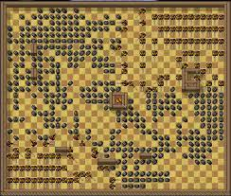
Cybersecurity
Medical Imaging
Gaming Strategies
Network Security
Intrusion Detection Systems
Image Processing & Analysis
Organ Segmentation
Game Pathfinding
Resource Management in Strategy Games

Slide 13

Military Strategies
Radar Placement
Base Placement

Slide 14
Existing Algorithms
Exact exponential:
Branch and Bound algorithm
Systematic way to explore the solution space
Time complexity is exponential
Worst case scenario , O(2^{n})
Approximation:
APPROX-VERTEX-COVER
Output can contain at most two times of the number of vertices in an optimal vertex cover.
Worst case scenario is a factor of at most two.
Randomized:
Randomized 2-Approximation
Probabilistic algorithm
find a vertex cover whose size is at most twice the size of the optimal vertex cover
has a linear expected running time

Slide 15
Existing Algorithms
Heuristic :
Xinshun Xu, Jun Ma(2005) An efficient simulated annealing algorithm for the minimum vertex cover problem
Yongfei Zhang, Jun Wu, Liming Zhang, Peng Zhao, Junping Zhou, and Minghao Yin(2018). An Efficient Heuristic Algorithm for Solving Connected Vertex Cover Problem
Meta Heuristic:
Anan Banharnsakun(2023). A new approach for solving the minimum vertex cover problem using artificial bee colony algorithm
Zuleyha Akusta Dagdeviren(2022). A Metaheuristic Algorithm for Vertex Cover based Link Monitoring and Backbone Formation in Wireless Ad hoc Networks

Slide 16
PACE 2019
Vertex Cover Problem was the 1st problem of PACE 2019
The winning solution was “We Got You Covered”
It solved 87 of the given 100 datasets
The second and third best solutions solved 77 and 76 datasets respectively

Slide 17
PACE 2019
Used aggressive Kernelization - repeated reduction of input by data reduction rules, mostly described by Takuya Akiba & Yoichi Iwata
Used techniques previously used to solve Maximum Independent Set & Maximum Clique Problem
Minimum Vertex Cover is the complement of Maximum Independent Set in the original graph
Minimum Vertex Cover is the complement of Maximum Clique in the complementary graph

Slide 18
Kernelization
A pre-processing step
Transforms the original graph into a smaller simplified version called Kernel
Made by applying reduction rules like
Pendant Vertex Removal - Removing Vertices of degree 1
Vertex Folding - Contracting neighbors of an edge with degree 2
Twin Vertex Reduction - Vertices having exact same neighborhood

Slide 19
Branch & Reduce
A paradigm that applies reduction rules while Branching

Slide 20
Phases
Preprocessing:
Compute a kernel using reduction rules
Use Iterated Local Search on the kernel to find a good initial solution
Branch-and-Reduce (Short):
Prime Branch-and-Reduce solver with initial solution
Run for a small time limit

Slide 21
Phases
3. Branch-and Bound(Short):
If Phase-2 is unsuccessful, run MoMC (Mix ordering Max Clique solver) on the complement of the kernel for short time limit
4. Branch-and-Reduce (Long):
Re-apply Phase-2 with longer time limit
According to Akiba & Iwata, a slightly longer time limit is able to catch most of the harder instances

Slide 22
Phases
5. Branch-and Bound(Long):
Run MoMC on the complement of the original graph until the allocated time ends
This was for the hardest problems that were unsolvable otherwise

Slide 23
Results of We Got You Covered
Reduced MoMC (RMoMC) in Phase-3 solved maximum number of instances
Local Search with Branch-and-Reduce (LSBnR) in Phase-2 came in second
Branch-and-Reduce without the help of Local Search (BnR) solved 3rd most number of instances
MoMC finished last

Slide 24
Approximation Algorithm
1805098

Slide 25
Implemented Algorithms
APPROX-VERTEX-COVER:
Given a G = (V, E), find a minimum subset C ⊆ V , such that C covers all edges in E, i.e., every edge ∈ E is incident to at least one vertex in C.
Firstly, we will initiate C as empty set.
Then we will iterate a loop to choose edges from G as long as there will be edges in G
In this loop, we will add the vertices (u,v) of chosen edge e to C
Then , will remove all the incident edges f of u and v from G
After completion of iteration, we will get the output C which will contain minimum number of vertices

Slide 26
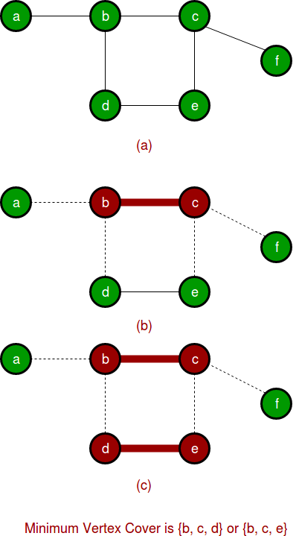
Implemented Algorithms
APPROX-VERTEX-COVER:
Pseudocode:
Algorithm:VertexCoverApprox(G, C)
C := ∅;
while G still has edges do
select an edge e = (v, w) of G;
add vertices v and w to C;
for each edge f incident to v or w
do
remove f from G;
end for
end while
return C

Slide 27
Simulation of APPROX-VERTEX-COVER
B
C
D
A
E
F
G

Slide 28
Simulation of APPROX-VERTEX-COVER
B
C
D
A
E
F
G

Slide 29
Simulation of APPROX-VERTEX-COVER
B
C
D
A
E
F
G
Vertex Cover Set = {C, D}

Slide 30
Simulation of APPROX-VERTEX-COVER
B
C
D
A
E
F
G
Vertex Cover Set = {C, D}

Slide 31
Simulation of APPROX-VERTEX-COVER
B
C
D
A
E
F
G

Slide 32
Simulation of APPROX-VERTEX-COVER
B
C
D
A
E
F
G
Vertex Cover Set = {A, B, C, D}

Slide 33
Simulation of APPROX-VERTEX-COVER
B
C
D
A
E
F
G
Vertex Cover Set = {A, B, C, D}

Slide 34
Simulation of APPROX-VERTEX-COVER
B
C
D
A
E
F
G
Vertex Cover Set = {A, B, C, D, E, F}

Slide 35
Simulation of APPROX-VERTEX-COVER
B
C
D
A
E
F
G
Vertex Cover Set = {A, B, C, D, E, F}
Vertex Cover Size : 6

Slide 36
Simulation of APPROX-VERTEX-COVER (Optimal Case Scenario)
D
B
C
A
E

Slide 37
Simulation of APPROX-VERTEX-COVER (Optimal Case Scenario)
D
B
C
A
E

Slide 38
Simulation of APPROX-VERTEX-COVER (Optimal Case Scenario)
D
B
C
A
E
Vertex Cover Set = {A, B}

Slide 39
Simulation of APPROX-VERTEX-COVER (Optimal Case Scenario)
D
B
C
A
E
Vertex Cover Set = {A, B}

Slide 40
Simulation of APPROX-VERTEX-COVER (Optimal Case Scenario)
D
B
C
A
E
Vertex Cover Set = {A, B}
Vertex Cover Set Size = 2

Slide 41
Worst Case Scenario
C
F
B
E
A
D

Slide 42
Worst Case Scenario
C
F
B
E
A
D

Slide 43
Worst Case Scenario
C
F
B
E
A
D
Vertex Cover Set = {C, F}

Slide 44
Worst Case Scenario
C
F
B
E
A
D
Vertex Cover Set = {C, F}

Slide 45
Worst Case Scenario
C
F
B
E
A
D
Vertex Cover Set = {C, F}

Slide 46
Worst Case Scenario
C
F
B
E
A
D
Vertex Cover Set = {B, C, E, F}

Slide 47
Worst Case Scenario
C
F
B
E
A
D
Vertex Cover Set = {B, C, E, F}

Slide 48
Worst Case Scenario
C
F
B
E
A
D
Vertex Cover Set = {B, C, E, F}

Slide 49
Worst Case Scenario
C
F
B
E
A
D
Vertex Cover Set = {A, B, C, D, E, F}

Slide 50
Worst Case Scenario
C
F
B
E
A
D
Vertex Cover Set = {A, B, C, D, E, F}
Vertex Cover Size : 6

Slide 51
Worst Case Scenario
C
F
B
E
A
D
Vertex Cover Size : 6
Optimal Vertex Cover Size = 3

Slide 52
Approximation Ratio 2
The proof is straightforward.
In each iteration we take two endpoints of edge (u, v). We know that to cover (u, v) edge at least one of them should be in our optimum vertex cover set. But we are picking both.
So, the solution of our approximation algorithm will be at most 2 times than that of optimal solution.
So approximation ratio = 2

Slide 53
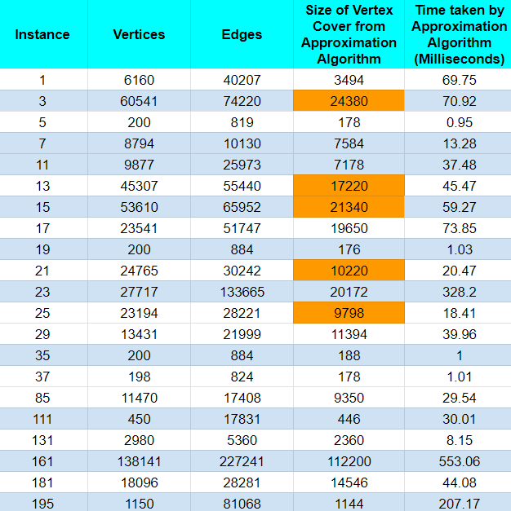
Results of Approximation Algorithm
Exactly twice the size of optimal

Slide 54
Randomized Algorithm
1805104

Slide 55
Implemented Algorithms
Randomized 2-Approximation
Let S denote the minimum number of vertex after completing iteration of the loop.
We have to iterate the loop for every e=(u,v) ∈ E where E is the set of edges
Then we will randomly choose u or v to add it to the set of vertices S where u or v does not belong to S
After completion of iteration, we will get our expected output set S.

Slide 56
Implemented Algorithms
Randomized 2-Approximation
Pseudocode:
Initialize S = ∅.
for all e = (u, v) ∈ E do
if neither u nor v belongs to S then
Randomly choose u or v with equal
probability.
Add the chosen vertex into S.
end if
end for
return S
B
C
D
A
E
F
G
B
C
D
A
E
F
G

Slide 57
Simulation of Randomized Algorithm
B
C
D
A
E
F
G

Slide 58
Simulation of Randomized Algorithm
B
C
D
A
E
F
G

Slide 59
Simulation of Randomized Algorithm
B
C
D
A
E
F
G

Slide 60
Simulation of Randomized Algorithm
B
C
D
A
E
F
G

Slide 61
Simulation of Randomized Algorithm
B
C
D
A
E
F
G

Slide 62
Simulation of Randomized Algorithm
B
C
D
A
E
F
G

Slide 63
Simulation of Randomized Algorithm
B
C
D
A
E
F
G

Slide 64
Simulation of Randomized Algorithm
B
C
D
A
E
F
G

Slide 65
Simulation of Randomized Algorithm
B
C
D
A
E
F
G

Slide 66
Simulation of Randomized Algorithm
B
C
D
A
E
F
G

Slide 67
Simulation of Randomized Algorithm
B
C
D
A
E
F
G

Slide 68
Simulation of Randomized Algorithm
B
C
D
A
E
F
G

Slide 69
Simulation of Randomized Algorithm
B
C
D
A
E
F
G

Slide 70
Simulation of Randomized Algorithm
B
C
D
A
E
F
G

Slide 71
Simulation of Randomized Algorithm
B
C
D
A
E
F
G

Slide 72
Simulation of Randomized Algorithm
B
C
D
A
E
F
G

Slide 73
Simulation of Randomized Algorithm
B
C
D
A
E
F
G
Vertex Cover = {B, C, E, F, G}
Size of vertex cover = 5
Optimal vertex cover size = 3

Slide 74
Simulation of Randomized Algorithm
(when leads to optimal)
B
C
D
A
E
F
G

Slide 75
Simulation of Randomized Algorithm
(when leads to optimal)
B
C
D
A
E
F
G

Slide 76
Simulation of Randomized Algorithm
(when leads to optimal)
B
C
D
A
E
F
G

Slide 77
Simulation of Randomized Algorithm
(when leads to optimal)
B
C
D
A
E
F
G

Slide 78
Simulation of Randomized Algorithm
(when leads to optimal)
B
C
D
A
E
F
G

Slide 79
Simulation of Randomized Algorithm
(when leads to optimal)
B
C
D
A
E
F
G

Slide 80
Simulation of Randomized Algorithm
(when leads to optimal)
B
C
D
A
E
F
G

Slide 81
Simulation of Randomized Algorithm
(when leads to optimal)
B
C
D
A
E
F
G

Slide 82
Simulation of Randomized Algorithm
(when leads to optimal)
B
C
D
A
E
F
G

Slide 83
Simulation of Randomized Algorithm
(when leads to optimal)
B
C
D
A
E
F
G

Slide 84
Simulation of Randomized Algorithm
(when leads to optimal)
B
C
D
A
E
F
G
Vertex Cover Size = 3 (optimal)

Slide 85
Approximation ratio of randomized approx-2-algorithm
Definitions:
OPT: Optimal vertex cover of minimal cardinality
S: Random vertex cover generated by our randomized algorithm
S_{i} : The contents of the set S after completing the i-th iteration of the loop
Loop invariant:
For all i,
E[|S_{i} ∩ OPT|] ≥ E[|S_{i} \ OPT|] …….(1)

Slide 86
Approximation ratio of randomized approx-2-algorithm (proof by induction)
Case-1 (Iteration where e = (u, v) is already covered by S_{i-1})
We take neither of the endpoints in S
We have S_{i} = S_{i-1} .
So, e^{qn} (1) clearly holds.

Slide 87
Approximation ratio of randomized approx-2-algorithm (proof by induction)
Case-2 (Iteration where e = (u, v) is not covered by S_{i} −1):
We know that, at least one of u an v belongs to OPT
Case | Which vertex is in S_{i} (vertex taken by randomized algo) | Which vertex is in OPT
1 | u | u
2 | v | u
3 | u | v
4 | v | v
5 | u | u, v
6 | v | u, v

Slide 88
Approximation ratio of randomized approx-2-algorithm (proof by induction)
Case-2 (Iteration where e = (u, v) is not covered by S_{i} −1):
S_{i} ∩ OPT
Case | Which vertex is in S_{i} (vertex taken by randomized algo) | Which vertex is in OPT
1 | u | u
2 | v | u
3 | u | v
4 | v | v
5 | u | u, v
6 | v | u, v
E[|S_{i} ∩ OPT|] has probability of greater than ½ to be increased by 1

Slide 89
Approximation ratio of randomized approx-2-algorithm (proof by induction)
Case-2 (Iteration where e = (u, v) is not covered by S_{i} −1):
S_{i} \ OPT
Case | Which vertex is in S_{i} (vertex taken by randomized algo) | Which vertex is in OPT
1 | u | u
2 | v | u
3 | u | v
4 | v | v
5 | u | u, v
6 | v | u, v
E[|S_{i} \ OPT|] has probability of less than ½ to be increased by 1

Slide 90
Approximation ratio of randomized approx-2-algorithm
Proof of induction step is completed which stands for
E[|S_{i} ∩ OPT|] ≥ E[|S_{i} \ OPT|] …….(1)
After all iteration is completed, we will get the set S. Hence,
E[|S ∩ OPT|] ≥ E[|S \ OPT|]
E[|S \ OPT|] <= E[|S ∩ OPT|]
E[|S \ OPT|] + E[|S ∩ OPT|] <= E[|S ∩ OPT|] + E[|S ∩ OPT|]
E[|S|] <= 2 * E[|S ∩ OPT|]
<= 2 * OPT
Hence, our algorithm is 2-approximation

Slide 91
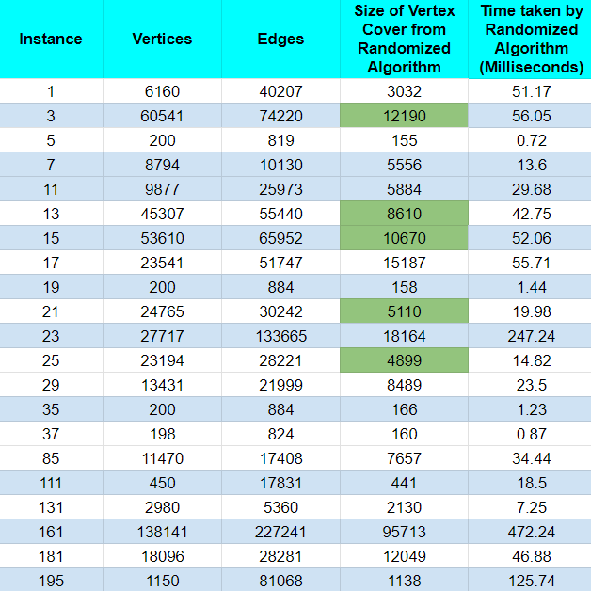
Results of Randomized Algorithm

Slide 92
Greedy Heuristic Algorithm
1805073

Slide 93
Implemented Algorithms
Greedy Heuristic
For all vertices find the vertex u with max degree.
Include u in the vertex cover set
Delete all the edges those has one endpoint u
Stop if the graph has no edge otherwise repeat step 1

Slide 94
Implemented Algorithms
Greedy Heuristic
Pseudocode:
Initialize S = ∅.
While the graph has edges
Find max degree vertex u
Add the chosen vertex u into S.
Delete u and adjacent edges of u
end while
return S

Slide 95
Simulation of Greedy Heuristic Algorithm
B
C
D
vertex cover = { }
A
E
F
G

Slide 96
Simulation of Greedy Heuristic Algorithm
B
C
D
vertex cover = {D}
A
E
F
G

Slide 97
Simulation of Greedy Heuristic Algorithm
B
C
D
vertex cover = {D}
A
E
F
G

Slide 98
Simulation of Greedy Heuristic Algorithm
B
C
vertex cover = {D, E}
A
E
F
G

Slide 99
Simulation of Greedy Heuristic Algorithm
B
C
vertex cover = {D, E}
A
E
F
G

Slide 100
Simulation of Greedy Heuristic Algorithm
B
C
vertex cover = {D, E}
A
F
G

Slide 101
Simulation of Greedy Heuristic Algorithm
B
C
vertex cover = {D, E, B}
A
F
G

Slide 102
Simulation of Greedy Heuristic Algorithm
B
C
vertex cover = {D, E, B}
A
F
G

Slide 103
Simulation of Greedy Heuristic Algorithm
C
vertex cover = {D, E, B}
A
F
G

Slide 104
Greedy Heuristic Algorithm
vertex cover = {D, E, B}
vertex cover size is 3 (which is equal to the optimal size!!!)

Slide 105
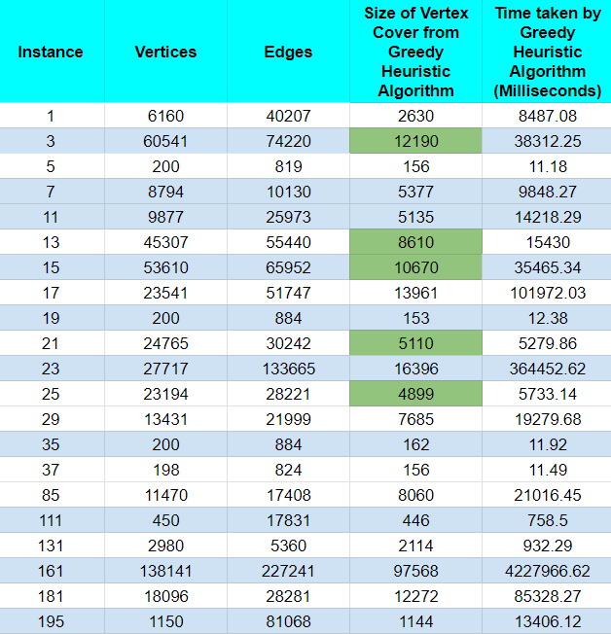
Results of Greedy Heuristic Algorithm

Slide 106
Combined
Result
Analysis

Slide 107

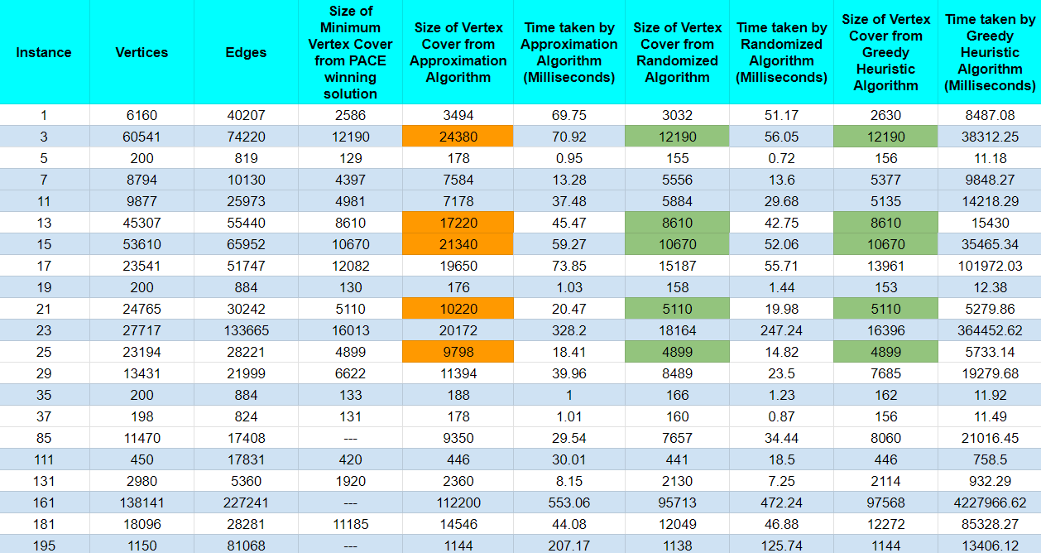
Results

Slide 108
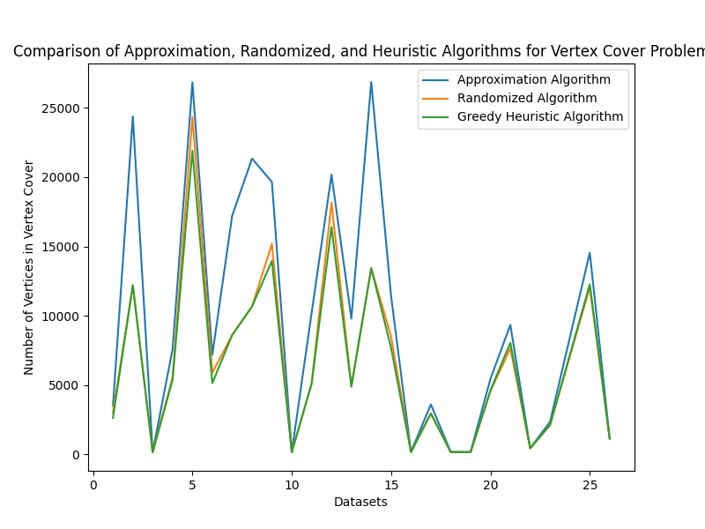
Graphical Representation of results in terms of number of vertices
Without the biggest Dataset

Slide 109
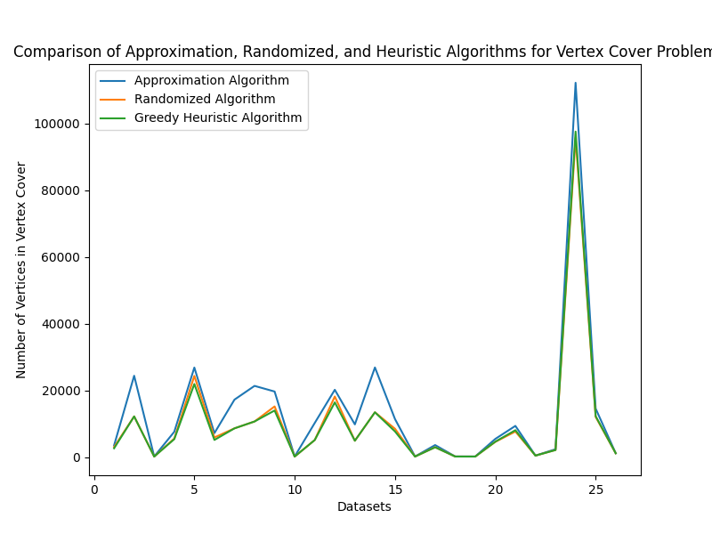
Graphical Representation of results in terms of number of vertices
With the biggest Dataset

Slide 110
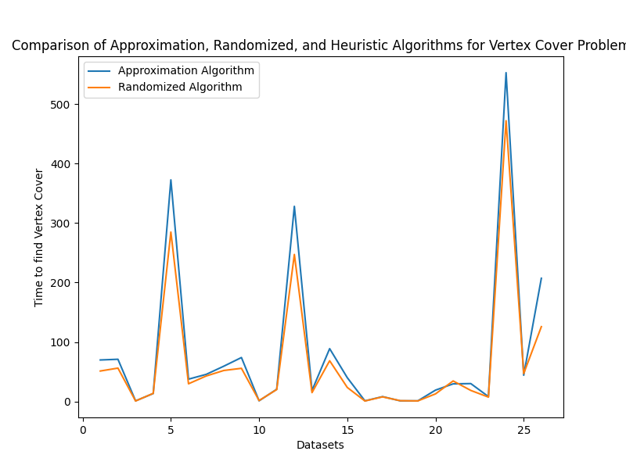
Graphical Representation of results in terms of times taken
Except Greedy Heuristic Algorithm

Slide 111
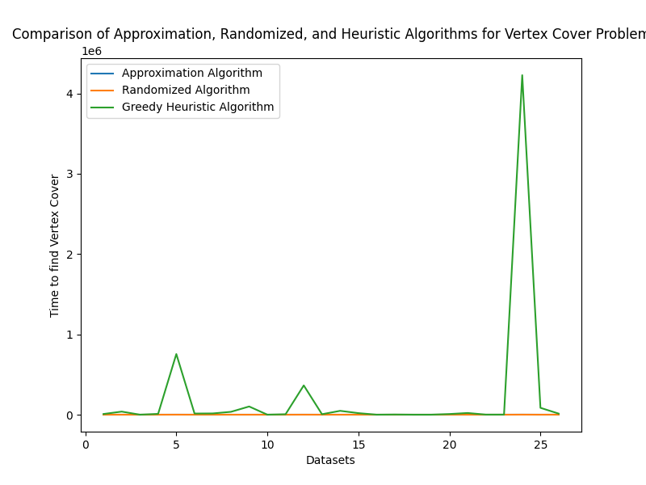
Graphical Representation of results in terms of times taken
Including Greedy Heuristic Algorithm

Slide 112
Result Analysis & Discussion
Approximation Algorithm
Was the worst among the other algorithms implemented
In 5 instances, the algorithm gave solutions two times worse than those of the winning solution of PACE 2019
In general inspection, worse solutions came in the datasets where the optimal vertex covers had less than half number of vertices than the original graph

Slide 113
Result Analysis & Discussion
Randomized Algorithm
Was better than the approximation algorithm and slightly worse than the greedy heuristic algorithm
In 5 datasets, the algorithm gave solutions exactly equal to the winning solution of PACE 2019
In general inspection, best solutions came in the datasets where the optimal vertex covers had less than half number of vertices than the original graph

Slide 114
Result Analysis & Discussion
Greedy Heuristic Algorithm
Was better than the other algorithms we implemented in terms of number of vertices in the vertex cover
Was worse than the other algorithms in terms of time
In 5 datasets, the algorithm gave solutions exactly equal to the winning solution of PACE 2019
In general inspection, best solutions came in the datasets where the optimal vertex covers had less than half number of vertices than the original graph

Slide 115
Github Link of Our Codebase

Slide 116
Thank You!

